Slide 1

ICFW Oscar- Best Feature
Media Scanner Service
DM: zhonglong.chen
DATE: 2014-1-9

Slide 2
Agenda
Overview
Usage
Status
Profit & Advantage
Team member

Slide 3
Overview
Media Scanner Service (MSS):
The media scanner service will read external storage and filter media files, retrieve them and save the media metadata to database.
It is designed to replace the native media scanner service in Android system, because the native service is not suitable for Smart TV platform:
Scanning large USB device make system response slow
Dismounting USB device make media server crash down while scanning

Slide 4
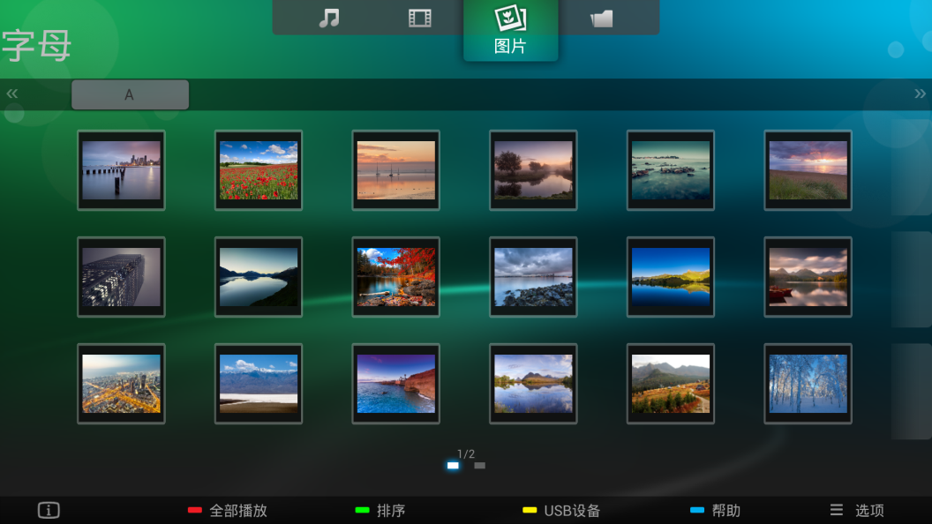
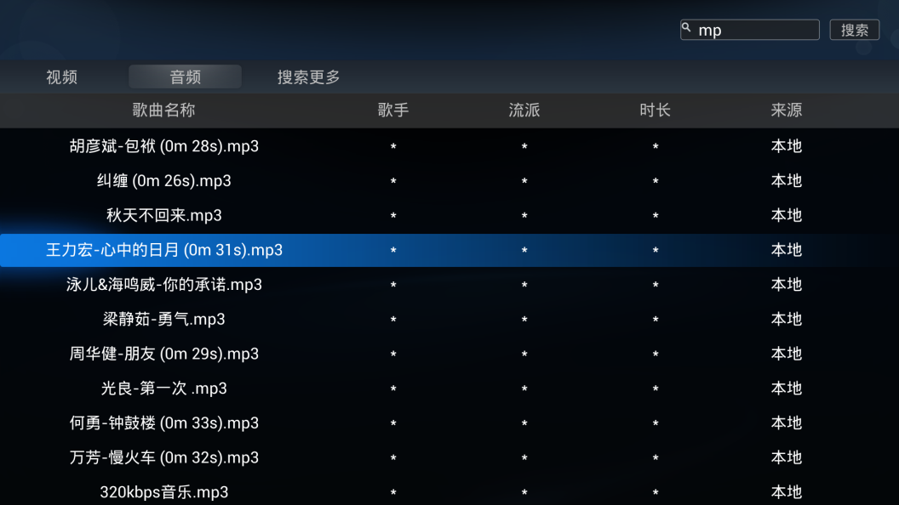
Usage
Usage:
MediaCenter
UniSearch
MediaCenter
UniSearch

Slide 5
Status
Imported:
Ebony 8830
Ebony 9340
Ebony 6940
Importing:
AOC Ots818

Slide 6
Profit & Advantage
Compared with native service, our media scanner service has more profit, such as:
Stability: Dismount USB will only kill our service, and other services and depended applications are OK.
Speed: Adjust scanner thread priority and idle time according to hardware performance and system loading.
Efficiency: Only retrieve necessary metadata of media file according to model function requirement.
Reusability: The media database is saved in external storage and will be reused next time.
Of cause, modifying native service directly has the same effect. However, as an independent feature, it will be easier to maintain.

Slide 7
Team member
Owner: 陈钟龙(zhonglong.chen)
Design Team
APP Team: 王月伟(yuewei.wang) 毛龙兴(lx.mao) 郑镇明(zhengzhm.zheng)
Test Team

Slide 8

Thank you!

